Slide 1

Just-in-Time Intervention
Final Sub Team Presentation

Slide 2
Introduction

Slide 3






Meet the Team!
Attush
Ania
Aashay
Saurabh
Lindsey
Cindy

Slide 4


Background of Project
Goal
Build a web application that predicts student outcome for any given course using a machine learning model.
Outcome
A Minimal Viable Product that predicts student outcome based on student grades and engagement data (attendance, click stream, log-in duration, etc) for any given course
Notes:
Saurabh

Slide 5
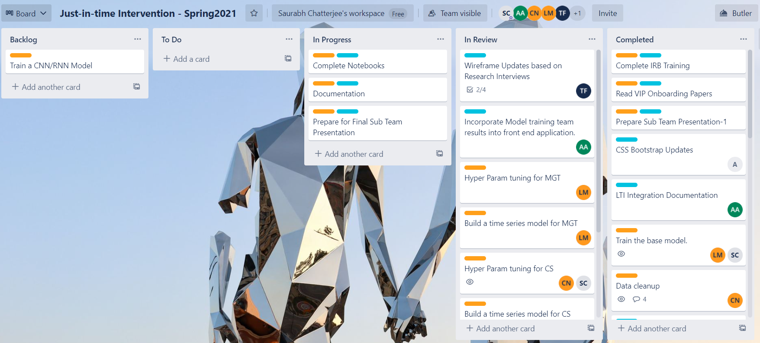
Logistical Accomplishments
❖ Attendance: 90% overall attendance for sub team meetings
❖ Trello: Team worked well using Trello tasks. Most tasks are completed or under review.
❖ Documentation: Extra focus on documentation for smoother hand-off
Notes:
Saurabh

Slide 6
Data Modeling Team

Slide 7


Data Modeling Team: Goal
Model Evaluation
Time Series
Compare
Goal : Apply predictive modeling techniques from previous semester to new dataset and compare the results of the two course to find correlations and patterns.
Paper: Student success prediction in MOOCs by Gardner & Brooks (University of Washington)
Goal : Evaluate the impact of time series clickstream data on predicting course progress and student success
Paper: Behavior-Based Grade Prediction for MOOCs via Time Series Neural Networks by Tsung-Yen Yang, Christopher Brinton (Princeton University)
Goal : Compare our results with a similar research
Paper: Mass attrition: An analysis of drop out from a Principles of Microeconomics MOOC by Rebecca M Stein and Gloria Allione (University of Pennsylvania)
Notes:
Saurabh

Slide 8
Progress Since Last Presentation
Time Series Modeling
Improved outlier removal approach
Fixed performance issues with data aggregation for CS course
Build a framework for time series modeling
Build Time Series Model for CS course
Build Time Series Model for MGT course
Compare STEM and non-STEM results for Time series modeling
Run time series learning technique to MGT100 and compare model performances with CS1301
Determine minimum weeks data required for predicting
Implement filtering techniques on the time series test set and generate a plot to determine the minimum amount/weeks of data required for making accurate prediction.
Adding synthetic data to the dataset to fix data imbalance
Implemented using a Python implementation of Synthetic Minority Over-Sampling Technique for Regression with Gaussian Noise (SMOGN).
Branco, P., Torgo, L., Ribeiro, R. (2017). SMOGN: A Pre-Processing Approach for Imbalanced Regression. Proceedings of Machine Learning Research, 74:36-50. http://proceedings.mlr.press/v74/branco17a/branco17a.pdf
Notes:
Saurabh

Slide 9
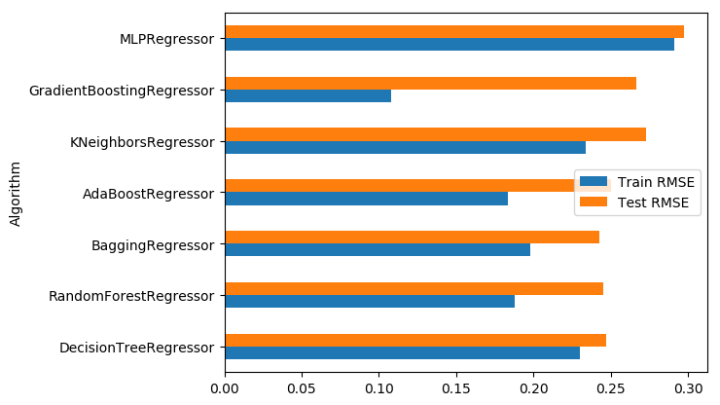
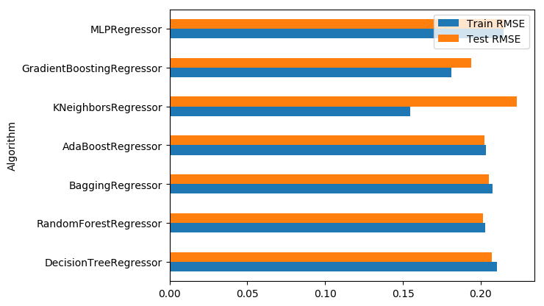
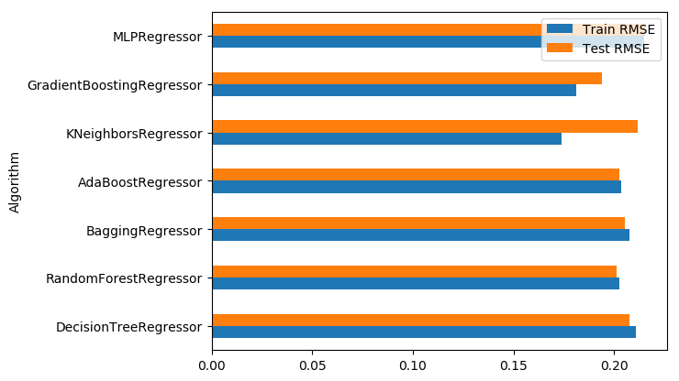
STEM vs Non-STEM Time Series Model Comparison
MGT100
CS1301
Gradient boosting performed best for both STEM and non-STEM
Interestingly, kNN performed well in the CV RMSE on the train set for the CS course.
On an average RMSE was higher in the non-STEM course, likely because of low volume of data.
Notes:
Cindy
Overall Gradient Boosting performed really well on the train data in both stem and non-stem courses, but not so much on test data
While interestingly Knn did best on the train data for the stem course but performed the worst on the test data which seems to indicate overfitting of the model on the train data
Overall the RMSE was higher in the non-STEM course, likely because of low volume of data.

Slide 10
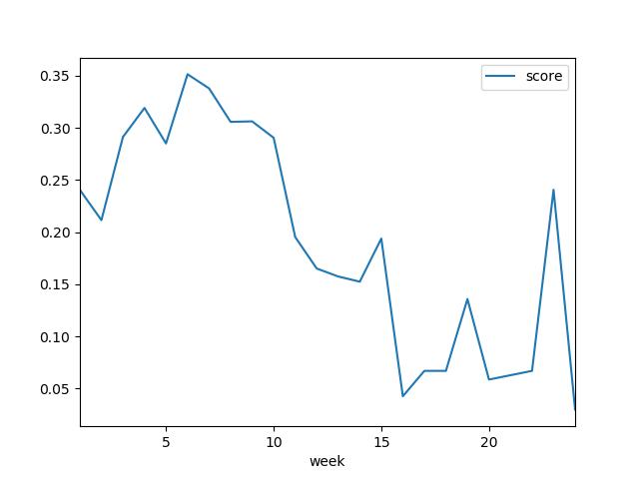
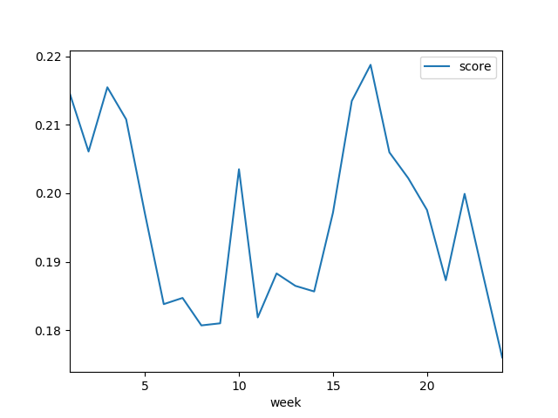
Data requirement before accurate prediction
MGT100
MGT100
For the initial few weeks, RMSE was high(0.3) and started to drop from Week-10 and from Week-15 it came down to about 0.05
It can be concluded that from week 10 the model will be capable of producing success with high accuracy.
CS1301
For the initial few weeks, RMSE was high(0.22) and started to drop from Week-7
It can be concluded that from week 7 the model will be capable of producing success with high accuracy.
Over variation is not too high because the data is very skewed to the left
CS1301
CS1301
Notes:
Lindsey
In our first sub-team presentation, we were asked by what week could a user expect to have an accurate prediction from our model.
After doing some model training we able to calculate this as seen here

Slide 11
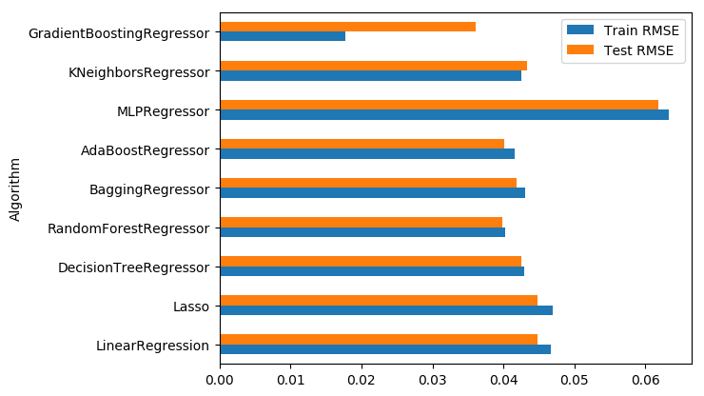
Aggregated vs Time Series Model Comparison
Aggregated Model
Time series Model
Used CS data for analysis
RMSE is much lower in the aggregated analysis because the final aggregated data is highly correlated with progress.
RMSE is higher in the time series analysis as the initial weeks are not able to provide good predictions.
Notes:
Saurabh

Slide 12



Future Scope
Due to data imbalanced the time series models are not performing at its best.
Test with data that has higher % complete(removing explorers).
Removing data with very high active weeks(>50) using sophisticated outlier removal techniques. Very likely these are instructors/TAs
Evaluate the use to true time series modelling techniques like CNN and RNN
If there is a way to add week-by-week progress data a true time series model can be run
Week progress can be extrapolated using a regression model and used
Adding a ETL process to store time series predictions for showing plots in the web app
Notes:
Saurabh

Slide 13
Web Development Team

Slide 14
UX Team: Progress since last presentation
UX Research and wireframe updates
Modified the existing wireframes based on UX research interview with Sonam
Proposed short term goals for the current(development) application based on UX Research.
Model Prediction in the web
Integrated the 4 models created by the ML team in the web application
Created wrappers for the models to encapsulate models
New Production App to match wireframes
Created a new instance of the web application to be used as production
Incorporated the wireframe designs for the Overview page into the production application.
Notes:
Ania

Slide 15
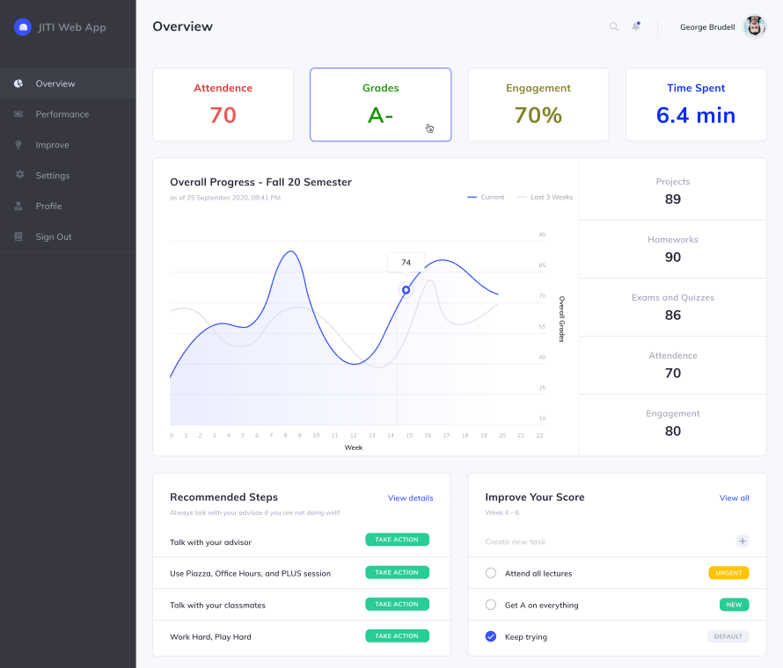
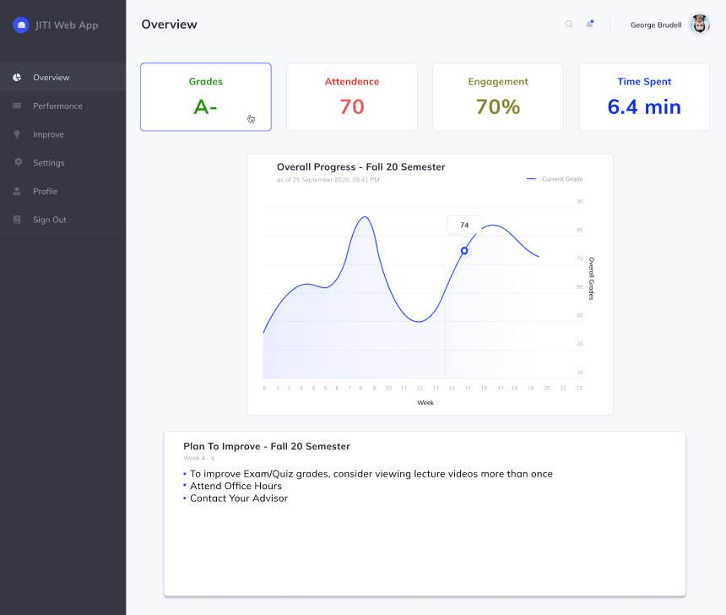
UX Research
Wireframe Updates
Overview Page Main Feedback: Overview page should be more informative than interactive and the importance of all overall progress information appearing on both the Overview and Performance page should reconsidered
Before
After
Notes:
Ania

Slide 16
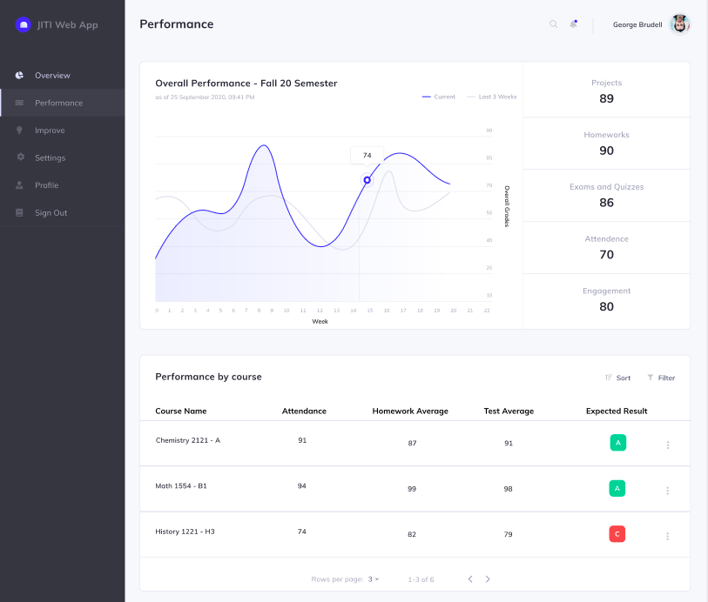
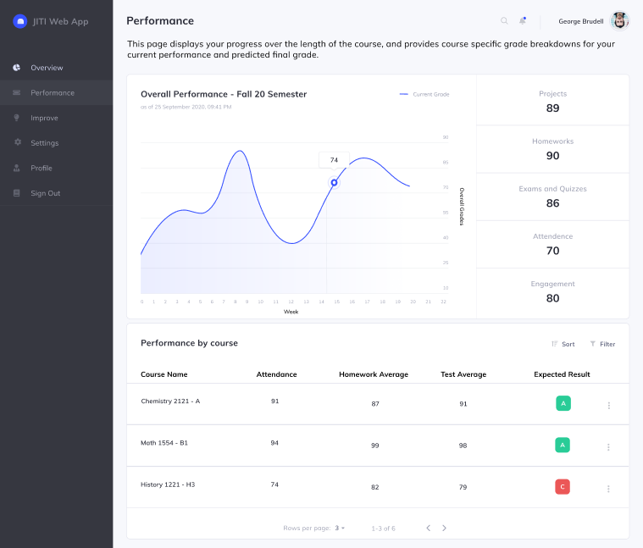
UX Research
Wireframe Updates
Performance Page Main Feedback: Remove previous weeks performance data underlay and provide more course specific information for students to browse
Before
After
Notes:
Ania

Slide 17
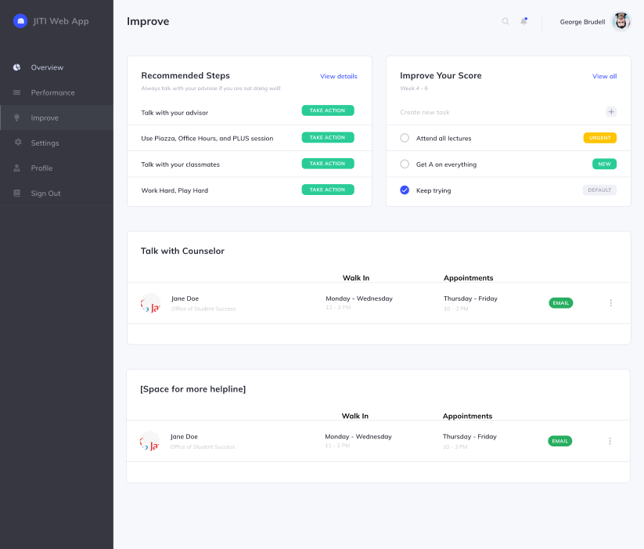
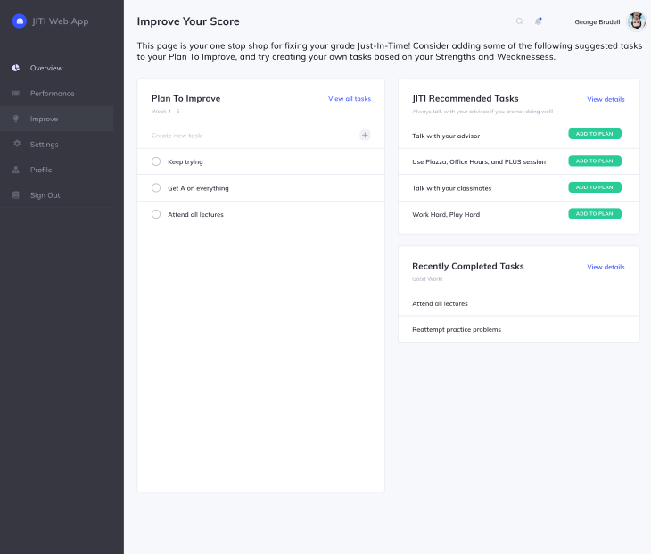
UX Research
Wireframe Updates
Improve Page Main Feedback: Be clear on how improvement task actions can be accepted and minimize visual clutter
Before
After
Notes:
Ania

Slide 18
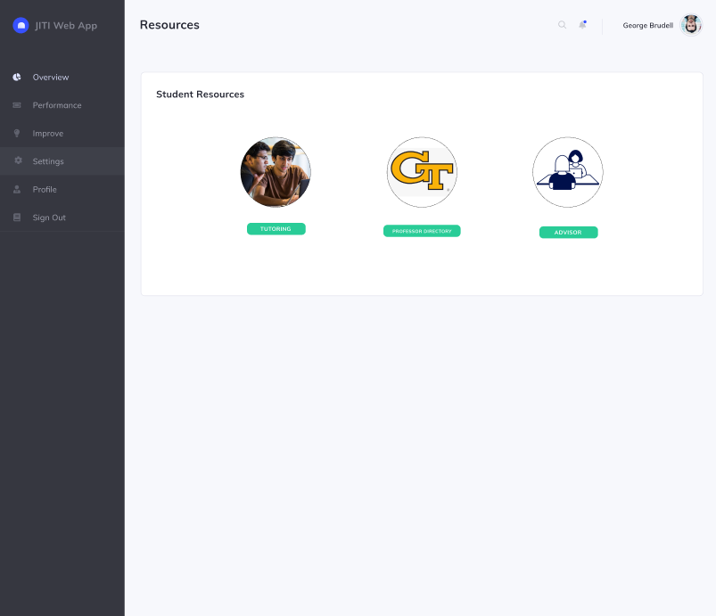
UX Research
Addition of Resources Page
The common resources that previously appeared at the bottom of the Improve Your Score page were moved to their own page for easy access
Notes:
Ania

Slide 19
Backend Update
Completed integrating the 4 models created by the ML team
Created new page with multiple inputs to support using the model
Inputs include taking in student id, week, and model information
Other things accomplished this semester:
Created wrappers for the models to encapsulate models
Spent a great amount of time researching Canvas OAuth Flow, including documentation
Plans for the future:
Implement a login flow (not through Canvas LTI)
Give suggestions on how user can improve based on information the models provide
Notes:
Aashay

Slide 20

Backend Demo

Slide 21
Frontend update
New production(prod) instance:
The production(prod) instance of the web application has been set up in github
The prod instance is a Flask based web application built using Python and SQL
Various open source tools such as Bootstrap, Argon Dashboard is used
Complete documentation for prod instance is also complete and available here
2 pages - Overview and Performance page is completed
Future goal:
Develop further pages and connect the app with the backend
Host the application on AWS/GCP
Notes:
Attush

Slide 22
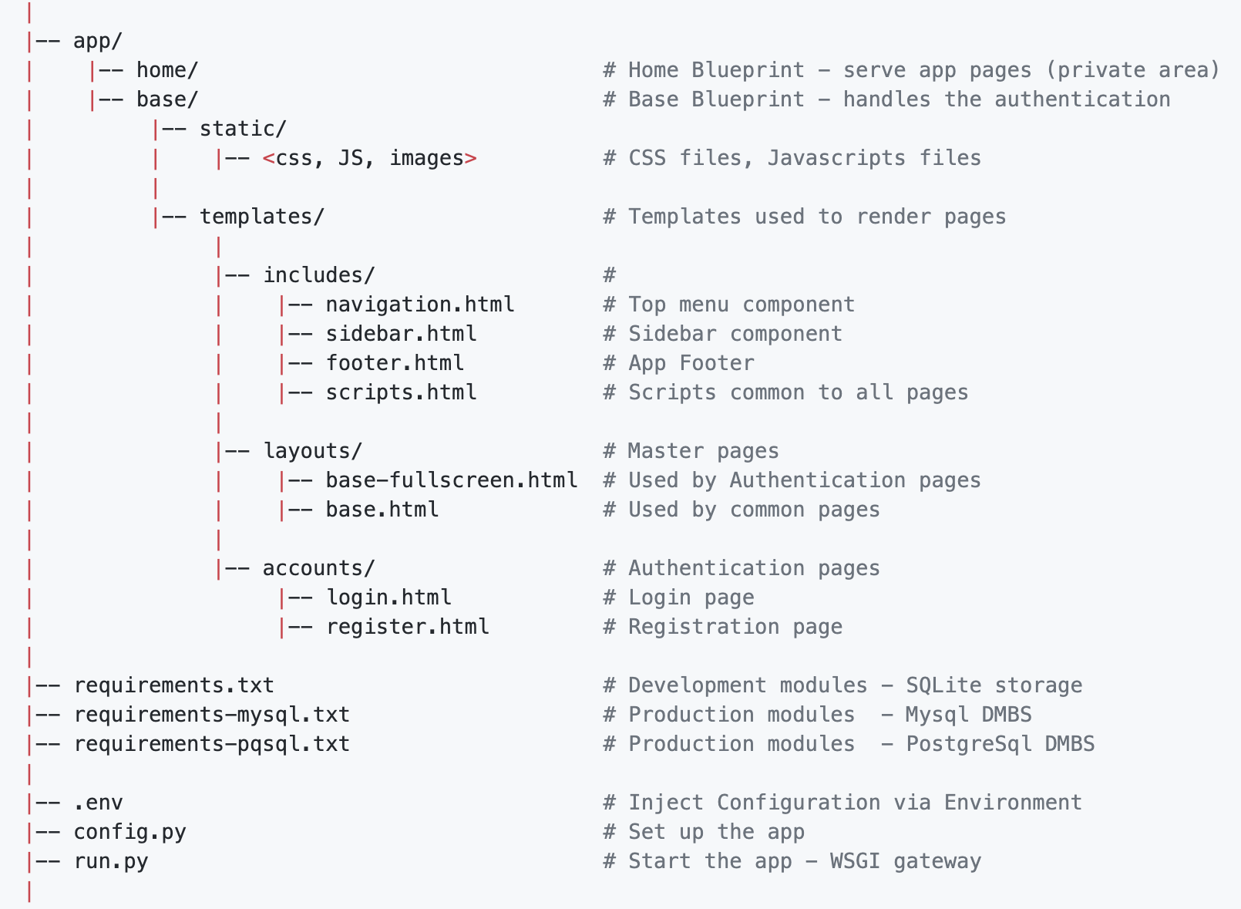
Frontend update
The Application Structure
Notes:
Attush

Slide 23
Frontend Demo

Slide 24
Conclusion
As a team we achieved a lot this semester
Highlights
UX Research and wireframe updates
New web application aligning to the wireframes
Explore multiple dataset for modeling and prove that the approach works well for most type of courses.
Aligning to our Project outcome Groundwork completed to get a MVP ready to be rolled out soon.
Notes:
Saurabh

Slide 25
Resources
General Resources
“Student Success Prediction in MOOCs” by Josh Garner and Christopher Brooks: https://arxiv.org/abs/1711.06349
ML Research Resources
“Behavior-Based Grade Prediction for MOOCs via Time Series Neural Networks” by Tsung-Yen Yang, Christopher Brinton(Princeton University): https://ieeexplore.ieee.org/document/7917237
“Mass attrition: An analysis of drop out from a Principles of Microeconomics MOOC” by Rebecca M Stein and Gloria Allione(University of Pennsylvania): https://economics.sas.upenn.edu/sites/default/files/filevault/14-031.pdf
UX Research Resources
“Motivating Students In Massive Open Online Courses (MOOCs)” by Kun Lee and David Richard Moore: https://www.oerknowledgecloud.org/archive/Li-Moore2018_Article_MotivatingStudentsInMassiveOpe.pdf
“No single solution helps all students complete MOOCs” Cornell University: https://www.sciencedaily.com/releases/2020/06/200615152116.htm
Notes:
Saurabh

Slide 26
Thank you!!

